Slide 1

Department of Computer Science
University Institute of Engineering
DEPARTMENT OF COMPUTER SCIENCE & ENGINEERING
Bachelor of Engineering
Subject Name: System Programming
Subject Code: CST-315
Compilers
DISCOVER . LEARN . EMPOWER

Slide 2
Chapter 8
Editors

Slide 3
EDITORS OR TEXT EDITORS
Editors or text editors are software programs that enable the user to create and edit text files.
In the field of programming, the term editor usually refers to source code editors that include many special features for writing and editing code.
Notepad, Wordpad are some of the common editors used on Windows OS
vi, emacs, Jed, pico are the editors on UNIX OS.
Features normally associated with text editors are — moving the cursor, deleting, replacing, pasting, finding, finding and replacing, saving etc.

Slide 4
Types of Editors
There are generally five types of editors as described below:
1. Line editor: In this, you can only edit one line at a time or an integral number of lines.
You cannot have a free-flowing sequence of characters.
The line must be explicitly specified by line number or by some pattern context.
It will take care of only one line.
e.g. Teleprinter, edlin, teco
eg. edlin editor in early MS-DOS systems.

Slide 5
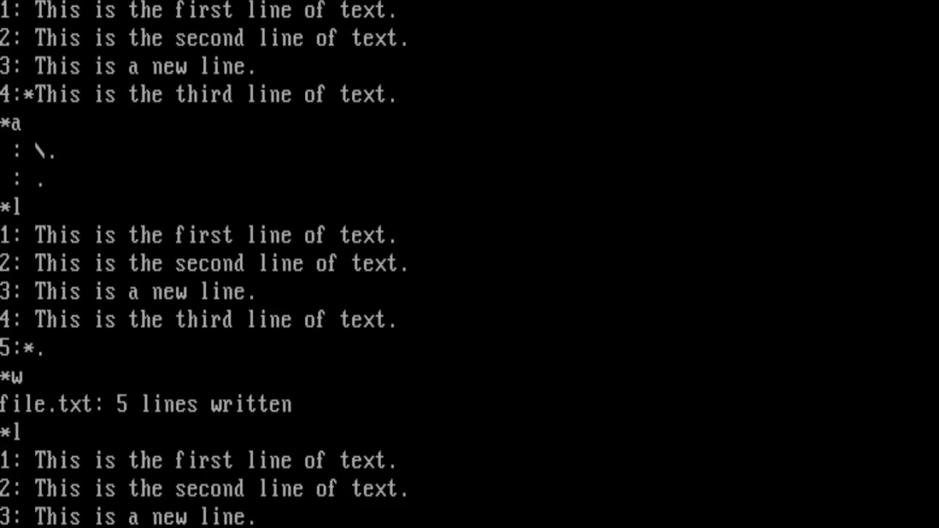
Types of Editors
eg. edlin editor in early MS-DOS systems.
Edlin is a line editor, and the only text editor provided with early versions of IBM PC DOS, MS-DOS and OS/2.
Although Superseded in MS-DOS 5.0 and later by the full-screen MS-DOS Editor, and by Notepad in Microsoft Windows,
it continues to be included in the 32-bit versions of current Microsoft operating

Slide 6
Types of Editors
2. Stream editors: In this type of editors, the file is treated as continuous flow or sequence of characters instead of line numbers, which means here you can type paragraphs.
The idea here is similar to line editor, but the entire text is treated as a single stream of characters.
Hence the location for revision cannot be specified using line numbers.
Locations for revision are either specified by explicit positioning or by using pattern context.
Line editors and stream editors are suitable for text-only documents.
eg. sed in Unix/Linux.

Slide 7
Types of Editors
eg. sed in Unix/Linux.
SED is a text stream editor used on Unix systems to edit files quickly and efficiently.
The tool searches through, replaces, adds, and deletes lines in a text file without opening the file in a text editor.
Learn how to use the sed command and its options through easy-to-follow examples
The main syntax for using the Linux sed command is:
sed OPTIONS... [SCRIPT] [INPUTFILE...]

Slide 8
Types of Editors
eg. sed in Unix/Linux.
SED is a text stream editor used on Unix systems to edit files quickly and efficiently.
The tool searches through, replaces, adds, and deletes lines in a text file without opening the file in a text editor.
Learn how to use the sed command and its options through easy-to-follow examples
The main syntax for using the Linux sed command is:
sed OPTIONS... [SCRIPT] [INPUTFILE...]

Slide 9
Types of Editors
sed OPTIONS... [SCRIPT] [INPUTFILE...]
The syntax for replacing text is:
sed 's/old_string/new_string/' filename.txt
Replace old_string with the text you want to substitute and new_string with the text you want to change it to.
For example, to replace instances of box with the word bin, run:
Sed 's/box/bin/' foxinbox.txt

Slide 10
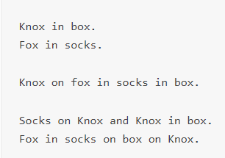
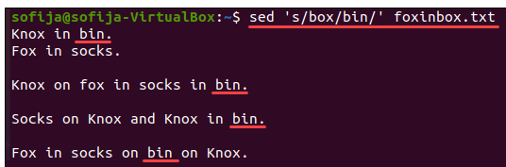
Types of Editors
Sed 's/box/bin/' foxinbox.txt

Slide 11
Types of Editors
Delete Specific Line Using the sed Command
To delete a line from a file with the sed command, use the d subcommand and the syntax:
sed '#d' filename.txt
sed '2d' foxinbox.txt
Delete Lines Within a Specific Range of Lines Using the sed Command
sed '2,4d' foxinbox.txt
The command above deletes lines 2, 3, and 4 from the file

Slide 12
Types of Editors
3. Screen editors: In this type of editors, the user is able to see the cursor on the screen and can make a copy, cut, paste operation easily. It is very easy to use mouse pointer.
These allow the document to be viewed and operated upon as a two dimensional plane, of which a portion may be displayed at a time.
Any portion may be specified for display and location for revision can be specified anywhere within the displayed portion.

Slide 13
Types of Editors
3. Screen editors: In this type of editors, the user is able to see the cursor on the screen and can make a copy, cut, paste operation easily. It is very easy to use mouse pointer.
These allow the document to be viewed and operated upon as a two dimensional plane, of which a portion may be displayed at a time.
Any portion may be specified for display and location for revision can be specified anywhere within the displayed portion.
Ex : vi, emacs, Notepad

Slide 14
Types of Editors
4. Word Processor: Overcoming the limitations of screen editors, it allows one to use some format to insert images, files, videos, use font, size, style features.
Provides additional features to basic screen editors.
Usually support non-textual contents and choice of fonts, style, etc.

Slide 15
Types of Editors
5. Structure Editor:
Structure editor focuses on programming languages.
It provides features to write and edit source code.
These are editors for specific types of documents, so that the editor recognises the structure/syntax of the document being prepared and helps in maintaining that structure/syntax.
Ex : Netbeans IDE, gEdit.

Slide 16
Some other editors:

Slide 17
Some other editors:
Full Screen Editors: is a text editor that occupies full display with the purpose of sidelining the user from the OS and the other applications.
It helps the user to focus on writing only and do not get distracted by the other applications and the cluttered interface.
Often fullscreen editors has a dark background and a text field with a light colored text.
They include customizable interfaces and feature like word count.
Ex : Acme, Coderoom, FocusWriter

Slide 18
Some other editors:
Multiple Window Editor: Multiple window editor allows you to work on more than one file one file at a time and cut and paste text from file into another via yanking and putting.
The two fundamental concepts that lie behind multi-window editors are buffer and windows.
Buffer: Buffer holds the text to be edited. A file only has one buffer associated with it.

Slide 19
Some other editors:
Windows: Windows provides a view to the buffer to see what the buffer holds and edit and modify it.
A buffer may have multiple windows.
Any changes made in any of the windows will be reflected in all other windows associated with the same buffer.

Slide 20
Some other editors:
Online Editors: Online text editors is an interface for editing the texts within a web browser. It aims to reduce the efforts made by the user by directly editing and updating into a valid HTML markup language.
Internet Explorer added first the feature of “design mode”.
The design mode allows the user to edit their document and it also allows the use of the cursor to do the editing.
Ex : CKEditor, SnapEditor, designmode by Internet Explorer.

Slide 21
Types of Editors
Salient Aspects of Text Editor
A text editor has to cover the following main aspects related to document creation, storage and revision -Interactive user interface
Appropriate format for storing the document in file in secondary storage
Efficient transfer of information between the user interface and the file in secondary storage.

Slide 22
Types of Editors
Editing Process
We all by now understand that editors are the program which is used to create, edit and modify a document.
A document may include some images, files, text, equations, and diagrams as well.
The document editing process mainly compromises of the following four tasks :

Slide 23
Editor Structure
The document editing process mainly compromises of the following four tasks :
The part of the document to edited or modifies is selected.
determining how to format this lines on view and how to display it.
Specify and execute the operations that modify the document.
Update the view properly.
The above steps include filtering, formatting, and traveling.
Formatting : Visibility on display screen.
Filtering : Finding out the main/important subset.
Traveling : Locating the area of interest.

Slide 24
Editor Structure
User Interface of editors: The user interface of editors typically means the input, output and the interaction language.
The input devices are used to enter text, data into a document or to process commands.
The output devices are used to display the edited form of the document and the results of the operation/commands executed.
The interaction language provides the interaction with the editor.
Interaction language : could be, typing oriented or text command-oriented or could be menu oriented user interface as well. Typing or text command-oriented interaction language is very old used with the oldest editors, in the form of commands, use of functions and control keys etc.

Slide 25
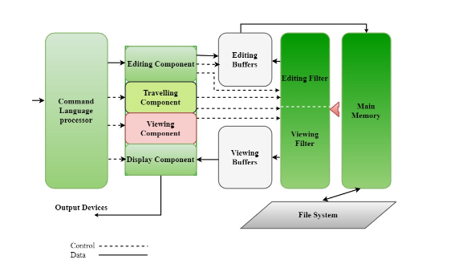
Types of Editors

Slide 26
Editor Structure
The command language processor accepts commands, performs functions such as editing and viewing.
It involves traveling, editing, viewing and display. Editing operations are specified by the user and display operations are specified by the editor. Traveling and viewing components are invoked by the editor or the user itself during the operations.

Slide 27
Editor Structure
Editing component is a module dealing with editing tasks. The current editing area is determined by the current editing pointer associated with the editing component. When editing command is made, the editing component calls the editing filter, generates a new editing buffer. Editing buffer contains the document to be edited at the current editor pointer location.

Slide 28
What is vi - visual editor?
VI editor : The vi editor (short name for the visual editor) is a screen editor which is available in UNIX OS.
Vi has no menus instead it uses a combination of keystrokes to accomplish tasks.
An improved version of vi is vim(vi improved).
Vi editor is usually available in all versions of UNIX OS, its implementation is very easy, it requires only a few resources and it is more user-friendly.
https://www.iopb.res.in/vimbook-OPL.pdf

Slide 29
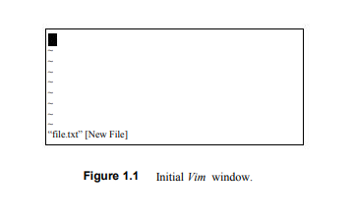
What is vi - visual editor?

Slide 30
What is vi?
vi is a screen-oriented text editor written by Bill Joy in 1976 for an early BSD release
In other words, it’s a text editor that uses command line on a Unix operating system

Slide 31
Basics about vi
Two modes
Insert mode
Command mode
It may appear cumbersome at first but the more you use it the more you’ll find its pretty well designed.

